Slide 1
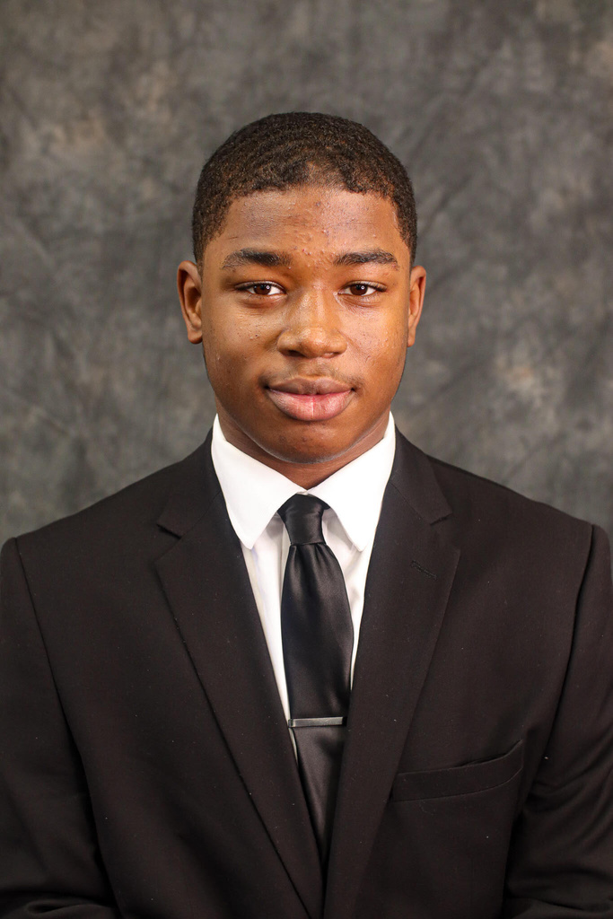
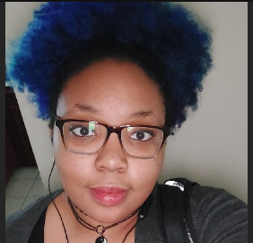


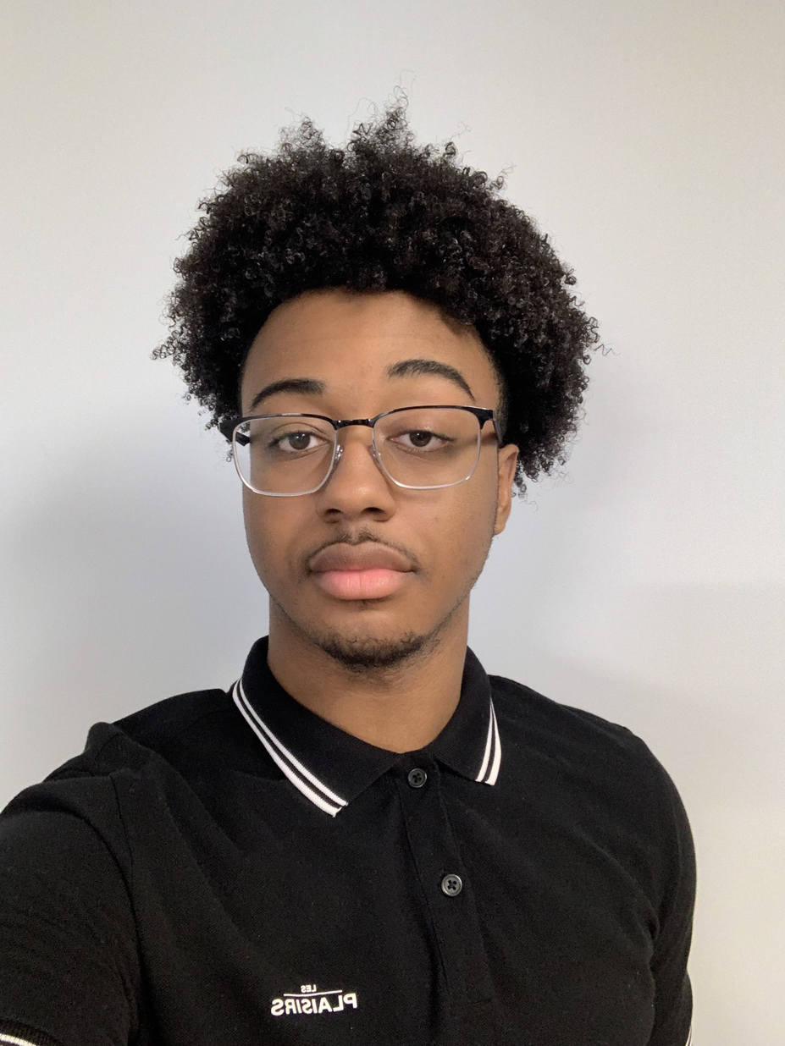
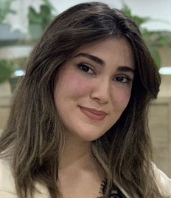
Key Miners:
THE DATA
MINERS
Devon
Lenasha
Lead Miners:
Jullie Salgado
&
Charlie Dey
Jovid
Theme song: What about your friends - TLC
kolin
Shovkat
Notes:
javid

Slide 2
THE DATA
Goals:
create foundational website - Devon
Make “About Us” - SHo
has logo, blurb, leaders
Create resources page -Kolin
Create a working newsletter data repo - Lenasha
Create a blog -Javid
MINERS
Theme song: What about your friends - TLC

Slide 3
THE DATA
Accomplished Goals:
Completed the Jekyll setup in local environment
Fix config file
Upload content
MINERS
Theme song: What about your friends - TLC

Slide 4
THE DATA
MINERS
New Goals:
Add images
Create working links
Create about us page
Theme song: What about your friends - TLC

Slide 5
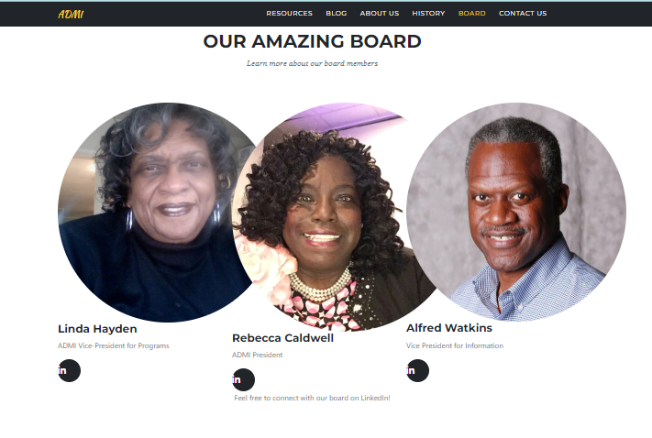
THE DATA
MINERS
demo
Theme song: What about your friends - TLC

Slide 6
THE DATA
MINERS
demo
https://lolli1486.github.io/agency-jekyll-theme/
Theme song: What about your friends - TLC

Slide 7
THE DATA
MINERS
future
Theme song: What about your friends - TLC

